Slide 1


OUTCOMES OF A QUICK HEALTH CERTIFIED

Slide 2

Achieving SEO Success for Quick Health Certified
This case study highlights the SEO journey of Quick Health Certified, showcasing remarkable improvements in organic traffic, authority score, and backlinks. Through a strategic combination of on-page and off-page optimization, organic traffic increased by 54%, with 287 keywords ranking in search results. Additionally, the authority score saw consistent growth, while backlinks surged from 45 to nearly 800, boosting domain visibility and credibility. These results reflect the effectiveness of a well-planned SEO strategy in driving sustainable growth.

Slide 3

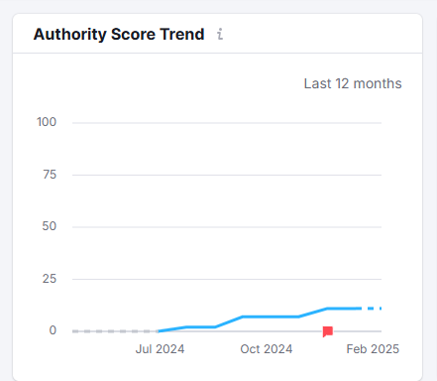
Authority Score Trend
As shown in the screenshot, authority increases through the implementation of both off-page and on-page strategies

Slide 4
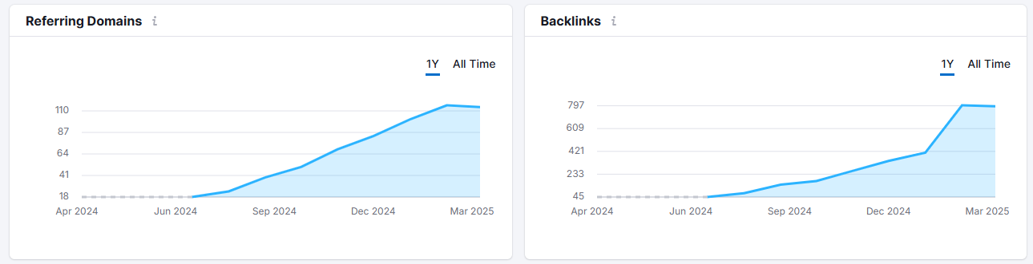
Growth in Backlinks
This snapshot highlights the growth in referring domains and backlinks through effective off-page and on-page SEO strategies. In one year, referring domains increased from 18 to over 100, while backlinks grew from 45 to nearly 800, boosting website authority and visibility

Slide 5
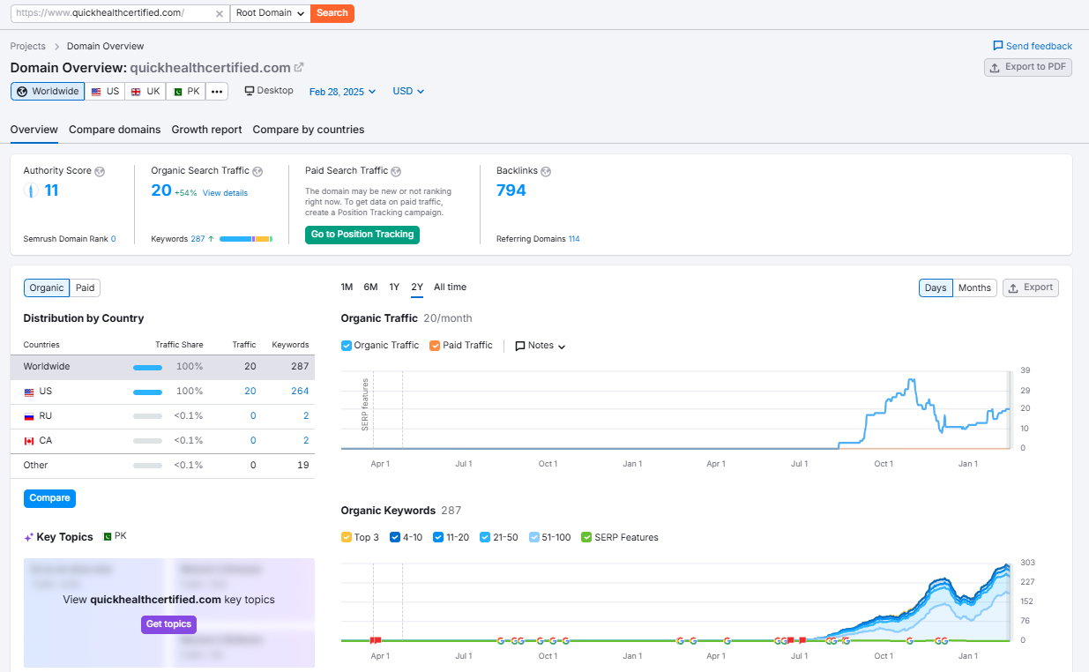
SEO Growth & Performance for Quick Health Certified
Organic search traffic has increased by 54%, with 287 keywords ranking in search results. These results showcase the effectiveness of off-page and on-page optimization in driving traffic and enhancing domain authority

Slide 6
THANK YOU

